Slide 1

Game Changer An NBA Data Analysis
Matthew Buonocore

Slide 2

Dynasty
Associate Of Science Degree In General Studies, North Idaho College
Outdoor Power & Recreational Vehicle Technology Certificate
Bethel School Of Technology Certificate | Data Science
Six Years Work Experience In Hospitality
Four Years Work Experience in Banking
Decades Of Basketball Playing & Viewing Experience

Slide 3
Starting Lineups
Why NBA Data?
Data Overview
Exploratory Examples
Analyses
Methods/Results
Interactive Model
Summary
Conclusions
Resources
Questions

Slide 4
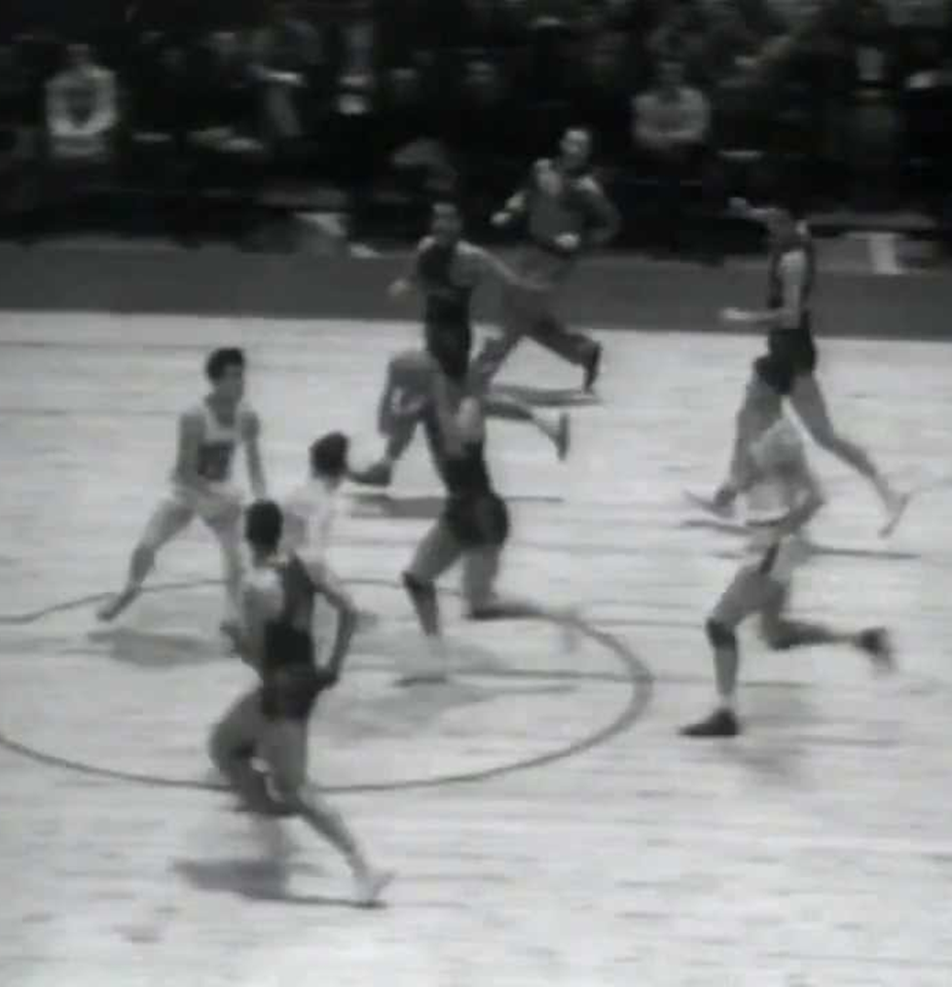
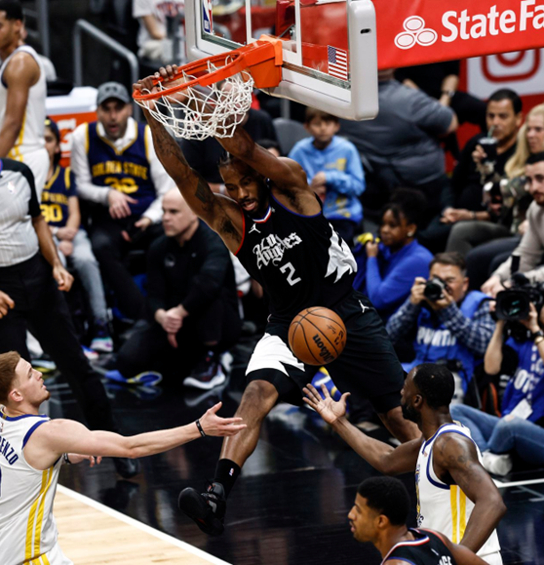
Notes:
I picked this data because growing up I…
The thing that really excited me about using this data was having access to the entire history of the nba stats. (76 years)

Slide 5
A Deep Roster…
Season
League
Team Name
Team Abbreviation
Did They Make The Playoffs
Games Played
Minutes Per Game
Field Goals Per Game
Field Goals Attempts Per Game
Field Goals Percentage
Three Pointers Made Per Game
Three Pointers Attempted Per Game
Three Point Percentage
Two Pointers Made Per Game
Two Pointers Attempted Per Game
Two Point Percentage
Free Throws Made Per Game
Free Throw Attempts Per Game
Free Throw Percentage
Offensive Rebounds Per Game
Defensive Rebounds Per Game
Total Rebounds Per Game
Assists Per Game
Steals Per Game
Blocks Per Game
Turnovers Per Game
Personal Fouls Per Game
Points Per Game
Age
# Of Wins
# Of Losses
Predicted Wins
Predicted Losses
Margin Of Victory
Strength Of Schedule
Simple Rating System
Offensive Rating
Defensive Rating
Net Rating
Pace
Free Throw Attempt Rate
Three Point Attempt Rate
True Shooting Percentage
Effective Field Goal Percentage
Turnover Percentage
Offensive Rebound Percentage
Free Throws Per Field Goal Attempt
Opponents Effective Field Goal Percentage
Opponents Turnover Percentage
Opponents Defensive Rebound Percentage
Opponents Free Throws Per FG Attempt
Arena
Season Attendance
Game Attendance
Notes:
Talk about my original data. (Very recent)
Two sets of team data. (Concatenated)
Basketball has always seemed like an ever-changing game…

Slide 6
Can The Entire History Of NBA Stats Be Used For Statistical Testing, Or Has The Game Changed Too Much?
Notes:
Which can be used to make predictions? And which ones are too different?

Slide 7
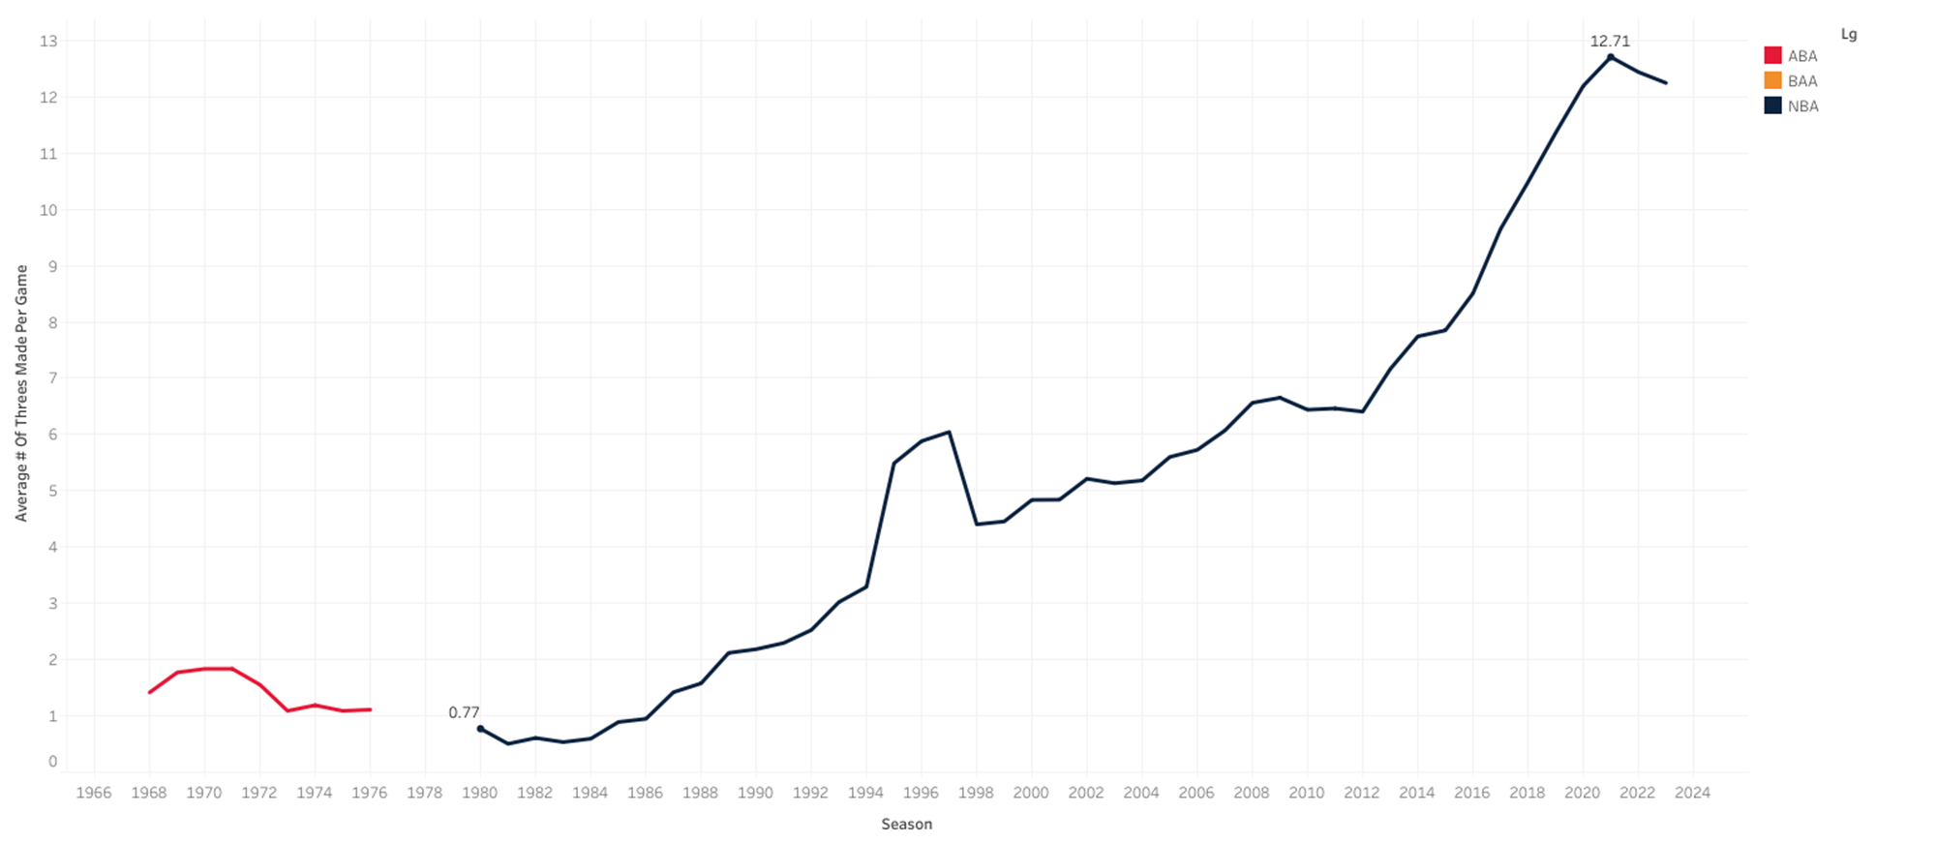
From Way, Downtown!
Notes:
The Basketball Association of America (BAA) was the predecessor to the NBA, and it did not have a 3-point shot during its existence from 1946 to 1949.
The BAA merged with the National Basketball League (NBL) in 1949 to form the NBA, which also did not initially adopt the 3-point shot.
It was not until 1979 that the NBA introduced the 3-point shot in its inaugural season in 1967.
The American Basketball Association (ABA) always had the 3-point shot during its short time span.
***SKIP FOR TIME***

Slide 8
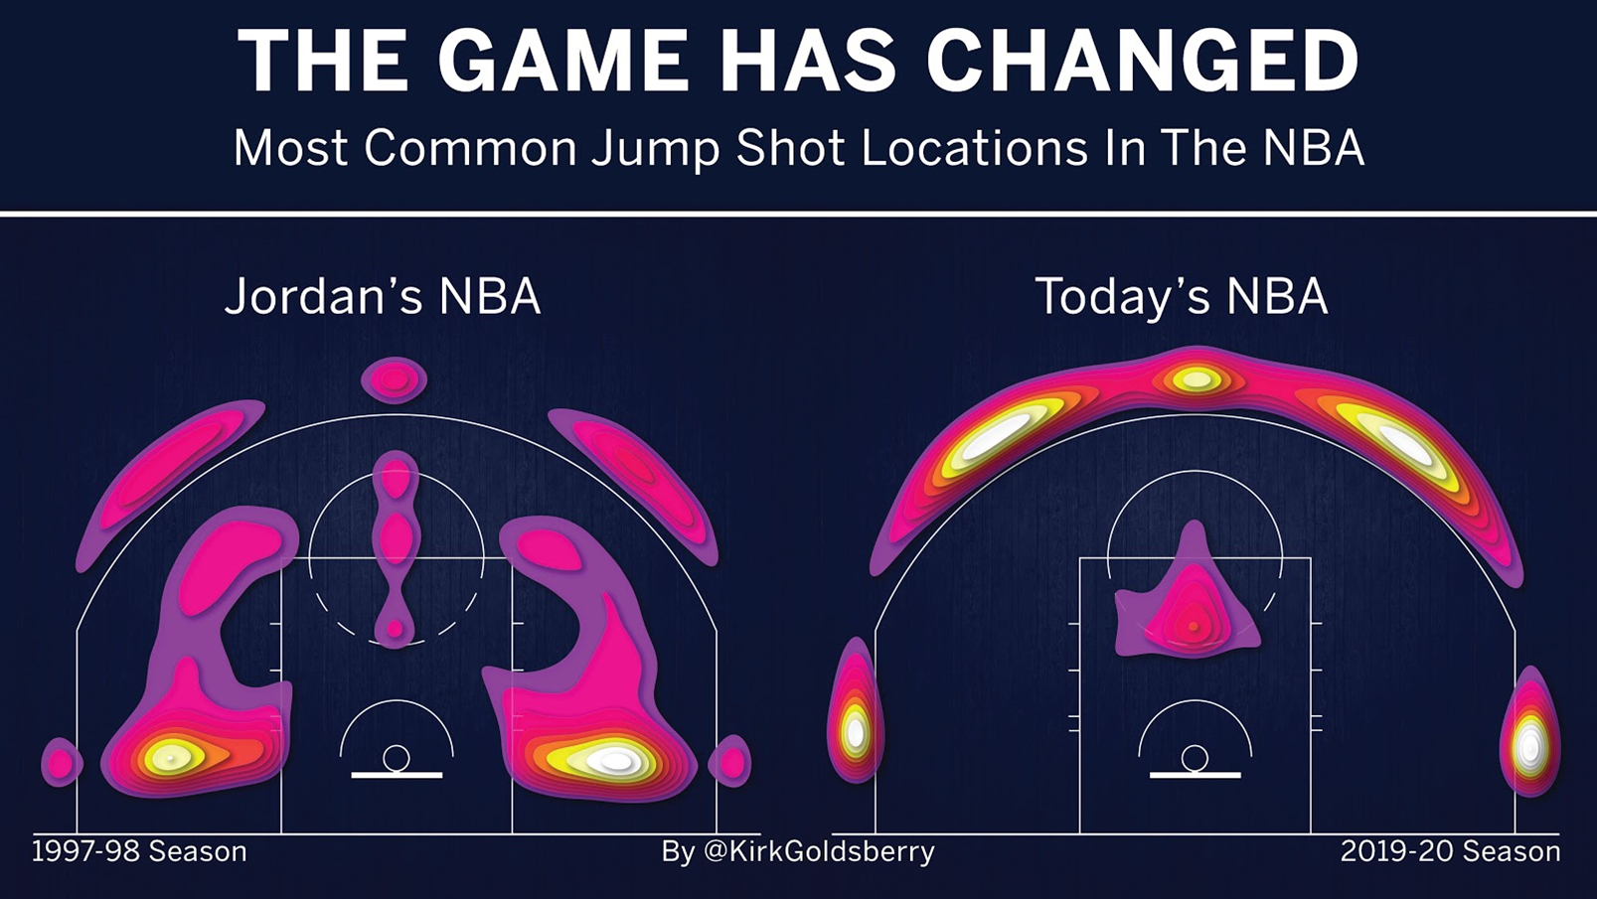
Offensive Substitution

Slide 9
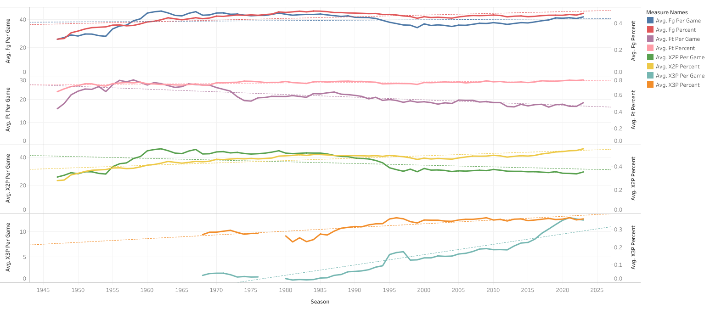
Offense Wins Games, But…
Notes:
FG’s and %

Slide 10
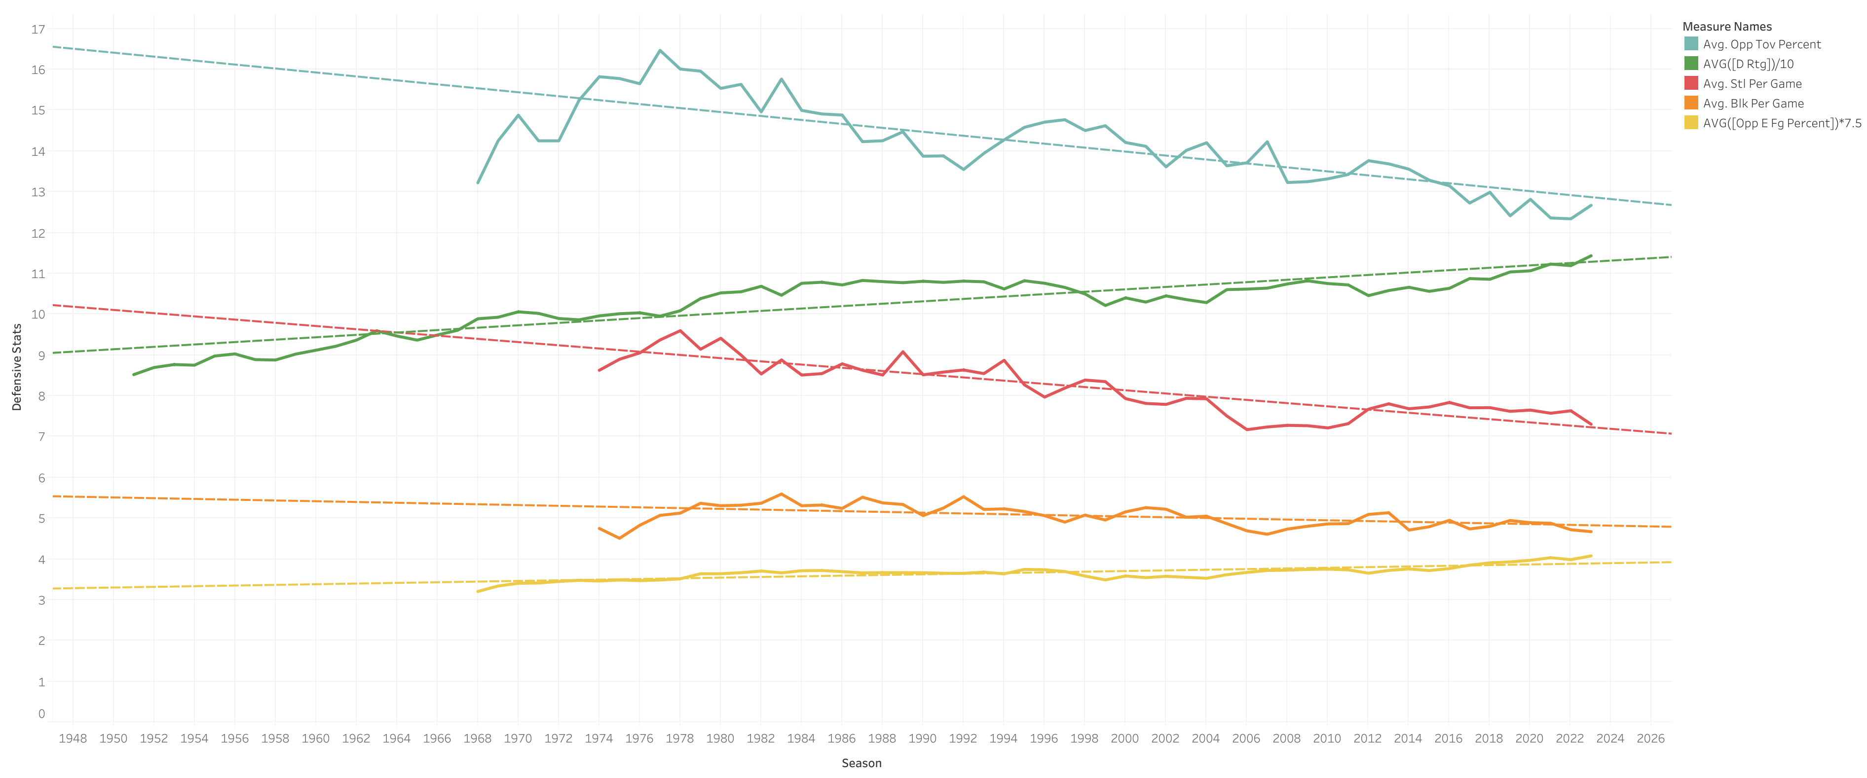
…Defense Wins Championships?
Notes:
eFG% = Weighted FG% (2’s and 3’s)

Slide 11
Gameplan (First & Second Quarter)
Which Teams Had The Most And Least Wins Over The Last Ten Years?
Is There A Relationship Between A Team's Shooting Percentages And Their Win-Loss Record?
Notes:
5 Analyses

Slide 12
Gameplan (Third & Fourth Quarter)
Do Teams That Have A Higher Number Of Turnovers Tend To Have A Worse Win-Loss Record? Is There A Certain Threshold Of Turnovers That Negatively Impacts A Team's Success?
Which Statistics Are The Most Strongly Correlated With Team Success? (Measured By Reaching Playoffs)
Notes:
5 Analyses

Slide 13
Gameplan (Overtime)
Can Machine Learning Algorithms Be Used To Predict The Outcome Of A Team’s Season?
Notes:
5 Analyses

Slide 14
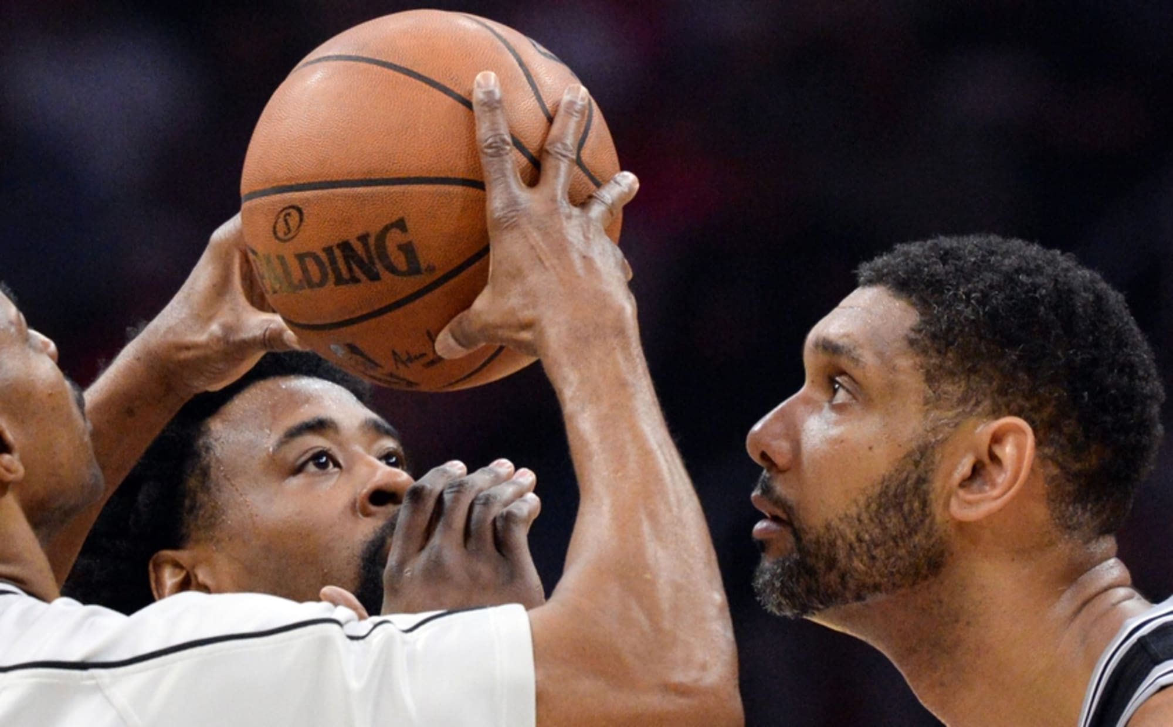
Tip-Off!
Notes:
Let’s Begin!

Slide 15
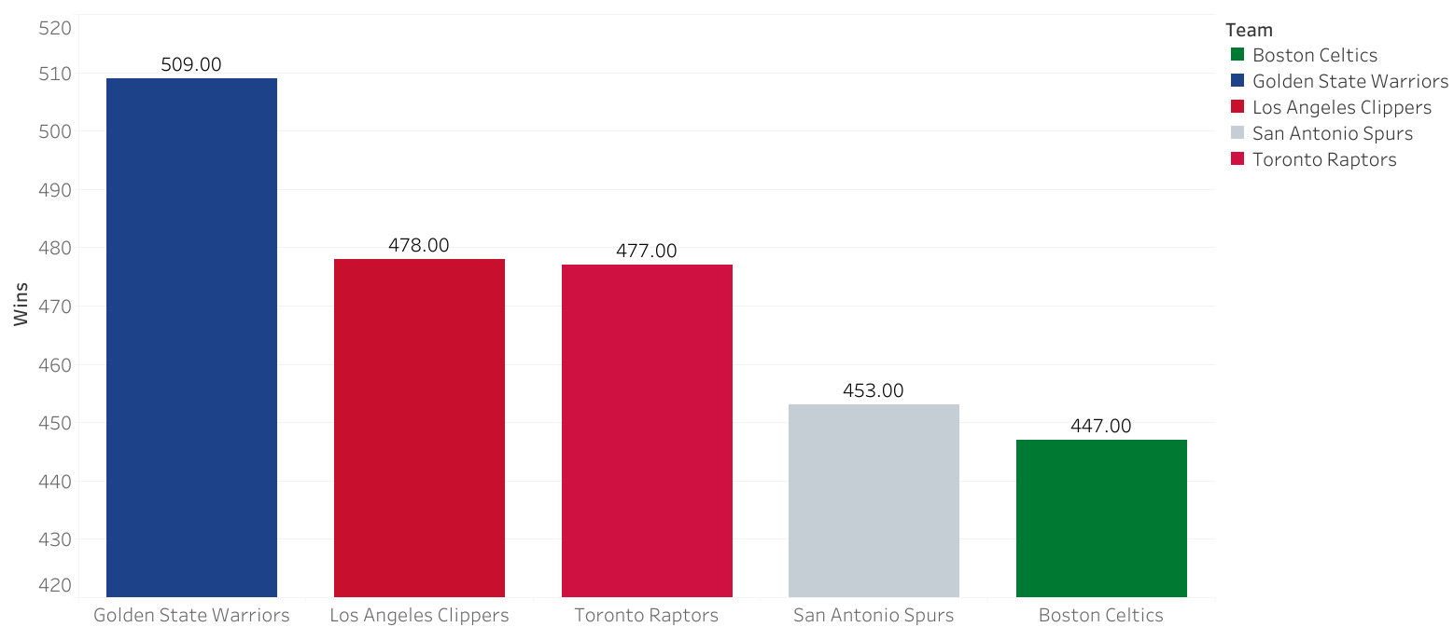





Q1. Teams With The Most Wins In The Last 10 Years

Slide 16
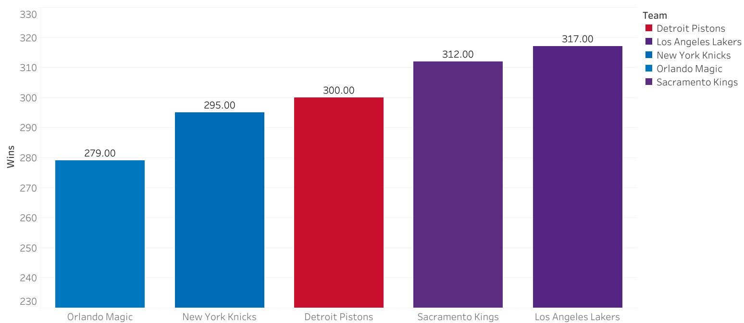





Q1. Teams With The Fewest Wins In The Last 10 Years

Slide 17
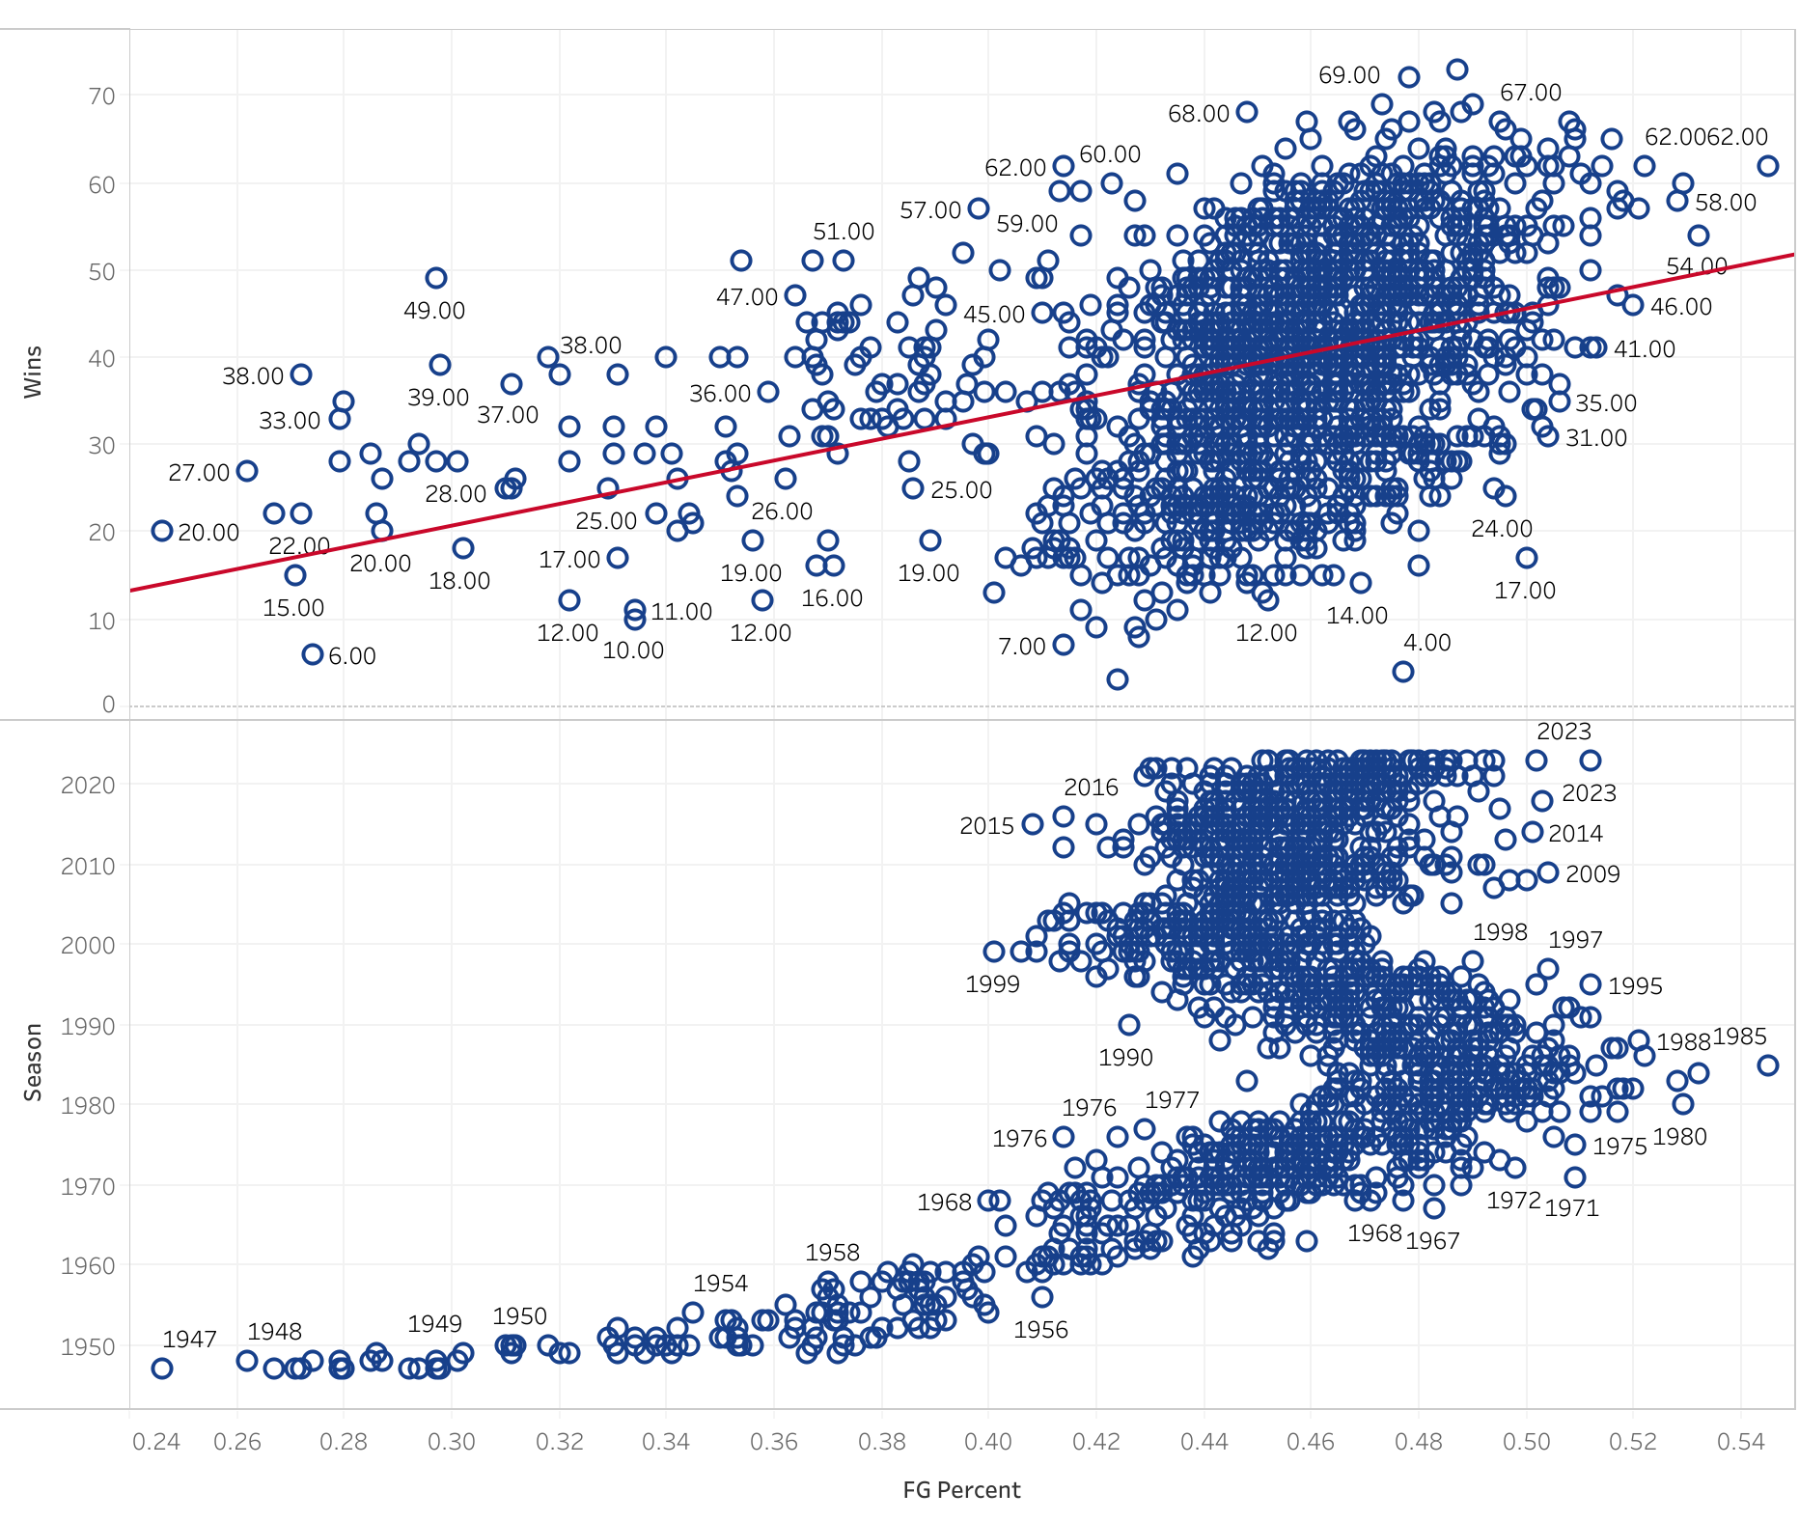
Q2. Shooting Percentage vs. Win-Loss Record?
FG Percentage
Moderate, Positive, Linear Relationship
Accounts For 15% Of Variation In Wins
Notes:
FG, 2PT, 3PT, TS Percentages.
Talk about amount of variation for each stat!
Linear regression

Slide 18
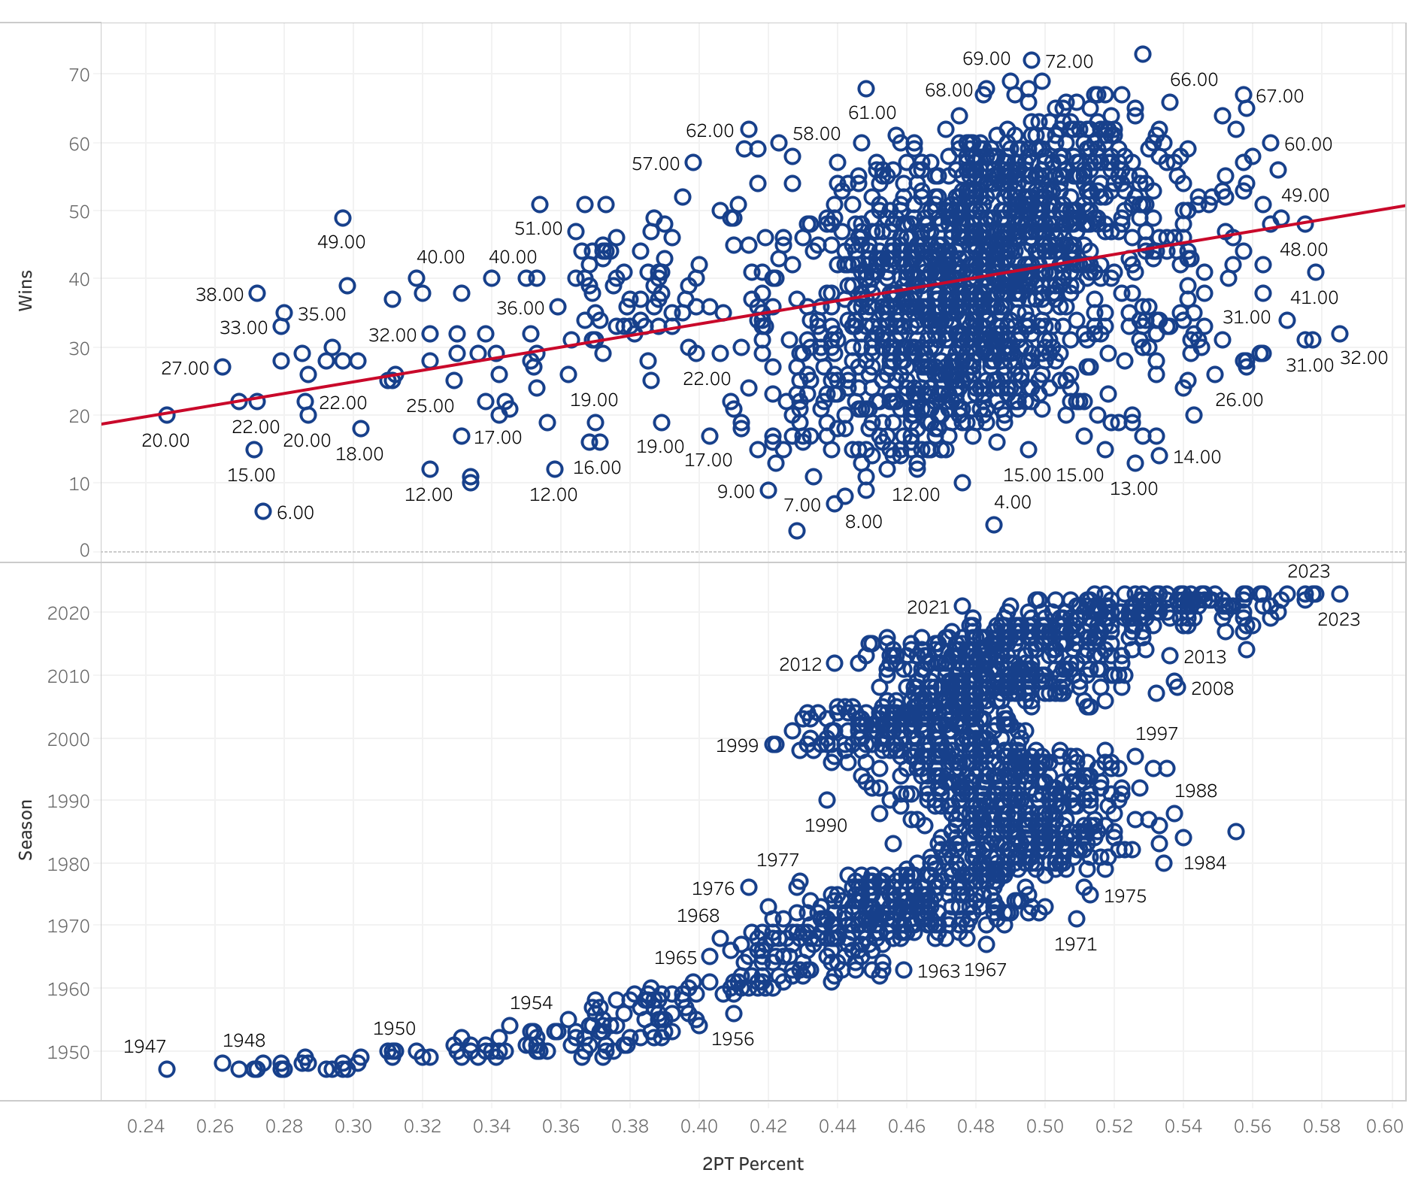
Q2. Shooting Percentage vs. Win-Loss Record?
2PT Percentage
Weak, Positive, Linear Relationship
Did Not Meet All Assumptions
Accounts For 8% Of Variation In Wins*
Notes:
FG, 2PT, 3PT, TS Percentages.
Talk about amount of variation for each stat!
Linear regression

Slide 19
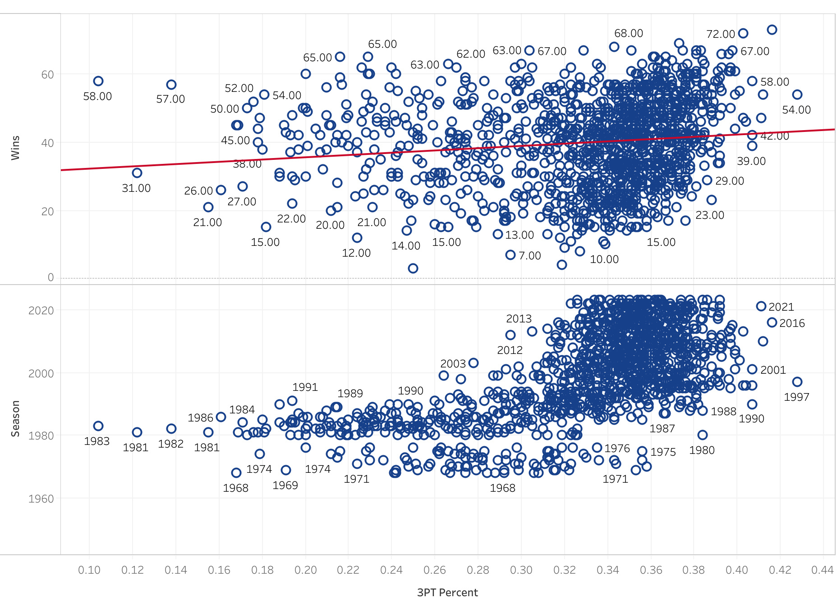
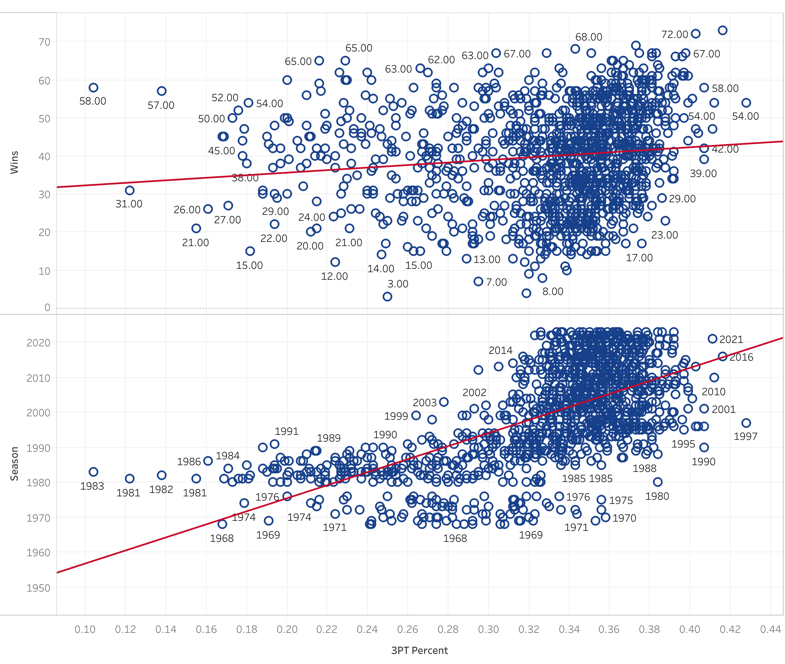
Q2. Shooting Percentage vs. Win-Loss Record?
3PT Percentage
Even Weaker, Positive, Linear Relationship
Accounts For 2% Of Variation In Wins
Notes:
FG, 2PT, 3PT, TS Percentages.
Talk about amount of variation for each stat!
Linear regression

Slide 20
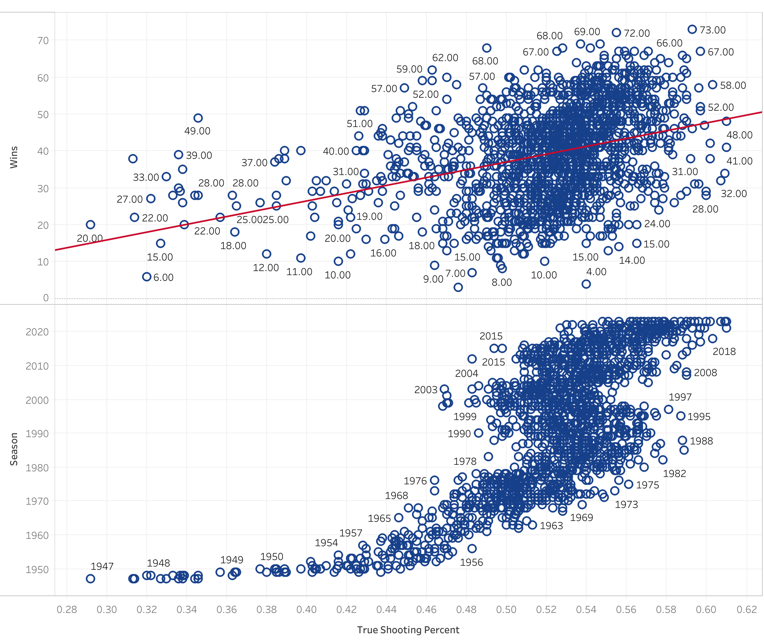
Q2. Shooting Percentage vs. Win-Loss Record?
True Shooting Percentage
Moderate, Positive, Linear Relationship
Accounts For 13% Of Variation In Wins
Notes:
FG, 2PT, 3PT, TS Percentages.
Talk about amount of variation for each stat!
Linear regression

Slide 21
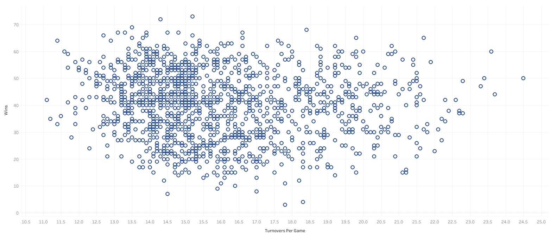
Q3. High Turnovers, High Losses?
Initial Model
Not Linear
Notes:
We’re looking for correlation here.
No linear relationship, had to do an exponential model

Slide 22
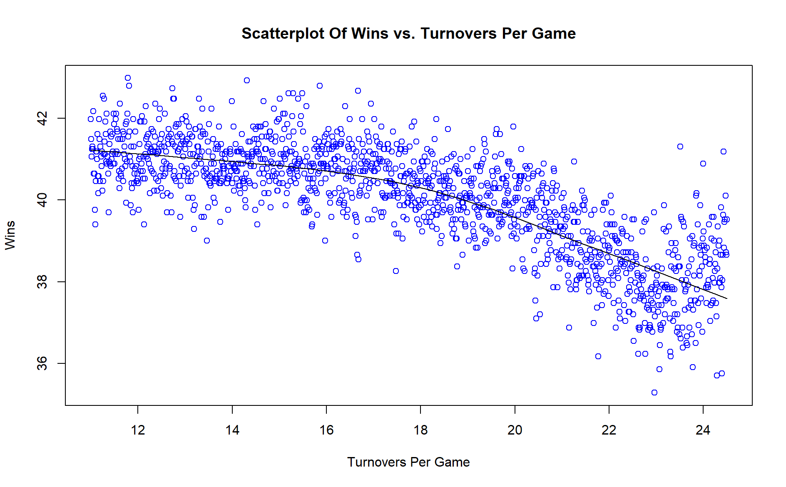
Q3. High Turnovers, High Losses?
Exponential Model
18 Turnovers Per Game Seems To Be The Threshold
Accounts For 1% Of Variation In Wins
Looks Can Be Deceiving…
Notes:
History looks like it skews this stat. The 20+ TO’s per game were mostly teams in the 70’s.
The highest average turnovers per game in the last ten years is the Philadelphia 76ers, with an average of 16.3 turnovers per game.
My best guess is that you would have to measure a more recent subset to get an accurate analysis

Slide 23
Q4. Most Valuable Team Stats?
Tested All Numeric Variables
Analysis Revealed Top 15 Variables
Assumption Testing Narrowed It Down To 5
Wins (p-value: 8.14e-16)
Defensive Rating (p-value: 2.72e-05)
Field Goal Attempts Per Game (p-value: 0.008)
Three Point Percentage (p-value: 0.028)
Turnovers Per Game (p-value: 0.031)
Notes:
Stepwise Binary Logistic Regression w/ backwards elimination

Slide 24
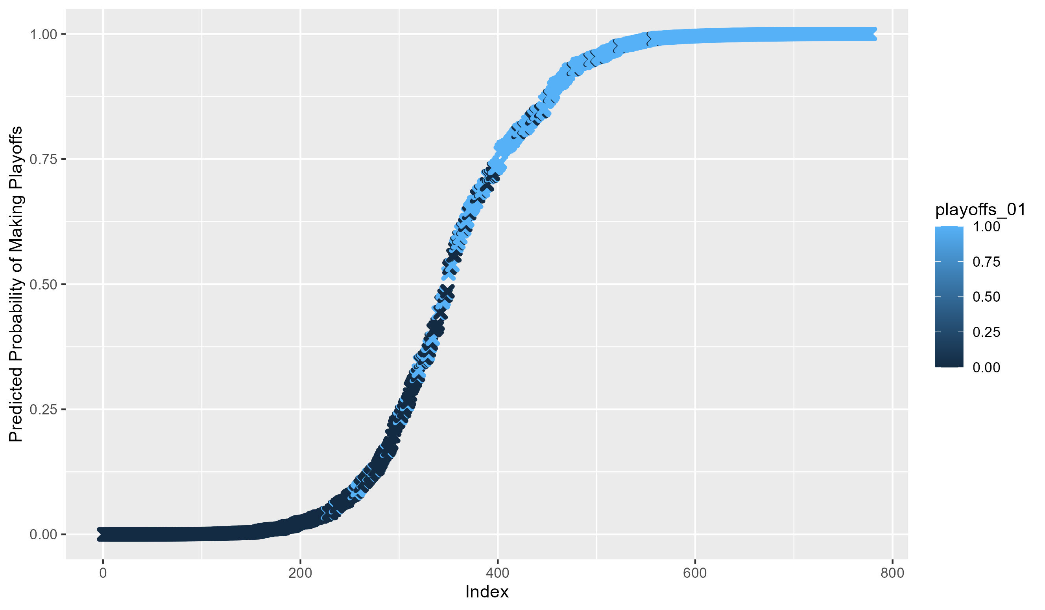
Q4. Most Valuable Team Stats?
Predicted If A Team Would Make The Playoffs
92.5% Accurate Using Only The 5 Variables
Notes:
Stepwise Binary Logistic Regression w/ backwards elimination
Analysis Revealed Top 15 Variables (93.6%)
Assumption Testing Narrowed It Down To 5 (92.5%)
Explain the graph

Slide 25
OT. Machine Learning The Game?
Tested All Numeric Variables
Initial Model Was 93.5% Accurate
Recursive Feature Elimination
Determined 10 Variables For Predictions
Those 10 Were Yielding 89.1% Accuracy
Notes:
Started similarly to last analysis.
Supervised ML. 70% learn, 30% test
Similar to backward elimination of last analysis
Was going to list the variables here, but I thought it would be easier to show you

Slide 26
OT. Machine Learning The Game?
Let’s Look At The Model In Action
For The Win…
Notes:
# Chicago Bulls Example Numbers: (3/25/23)
# .489
# .551
# 113.4
# 112.4
# Net
# .331
# .588
# .550
# .257
# .541
# Current Record 35-38, 9 games remaining in season. (3/25/23)
# Predicted 39 Wins. Actual amount today...?

Slide 27
OT. Machine Learning The Game?
Field Goal Percentage
Two Point Percentage
Offensive Rating
Defensive Rating
Net Rating
Three Point Attempt Rate
True Shooting Percentage
Effective Field Goal Percentage
Free Throws Per Field Goal Attempted
Opponents’ Effective Field Goal Percentage
Notes:
In case you missed those 10 variables

Slide 28

Highlights
Team Shooting Percentages
Field Goal, Three Point & True Shooting Showed Significant Impacts To Team’s Wins
Turnovers
Skewed By Historical Data
Top Playoff Factors
Wins, Defensive Rating, Field Goal Attempts Per Game, Three Point Percentage, Turnovers Per Game
Machine Learning
Successfully Predicted A Current Season Outcome
Notes:
Summary

Slide 29
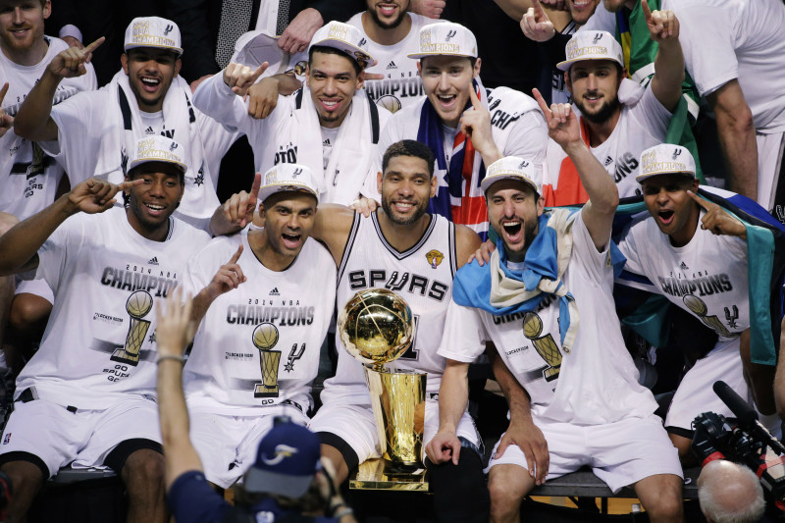
Post Game Analysis
The Entire History Of NBA Stats Can Be Used For Statistical Testing, Despite The Changes Over The Years!
Notes:
Time Duncan winning championships in 3 different decades

Slide 30









Assist Leaders

Slide 31
Scoring Leaders
https://www.kaggle.com/datasets/sumitrodatta/nba-aba-baa-stats
https://www.basketball-reference.com
https://rstudio-pubs-static.s3.amazonaws.com/321493_ca996c72e6834adb9eb78e0d5be975f7.html
https://streamlit.io/
https://medium.com/@maziarizadi/pickle-your-model-in-python-2bbe7dba2bbb
https://www.youtube.com/watch?v=nUOh_lDMHOU
https://www.youtube.com/watch?v=Ebb4gUI2IpQ
https://teamcolorcodes.com/
https://fontslogo.com/nba-logo-font/
https://www.espn.com/nba/story/_/id/29113310/seven-ways-nba-changed-michael-jordan-bulls
https://www.schemecolor.com/national-basketball-association-logo-colors.php
https://fansided.com/2016/03/03/jump-ball-winning-and-losing-streaks/
https://www.si.com/nba/raptors/news/nba-to-announce-expansion-teams-las-vegas-seattle-during-preseason
https://bleacherreport.com/articles/2098311-spurs-tim-duncan-becomes-1st-player-to-start-and-win-championships-in-3-decades
This presentation has been designed using resources from PoweredTemplate.com

Slide 32
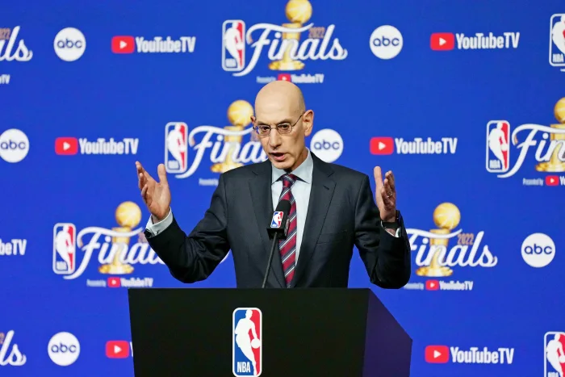
Press Conference
Questions?

